Slide 1

Hearing Impaired Communication System for Deaf
7

Slide 2

TEAM MEMBERS
Sriharish T
Yogeshwaran B
Nattu Durai C
Kishore Kumar K
Mahalakshmi R
Ravi Varman K

Slide 3


TITLE
DESCRIPTION
PROBLEM STATEMENT
Enabling communication strategies for persons with hearing impairment
In individuals with impaired hearing, determining the direction of sound is a significant problem. The direction of sound was determined in this work, which allowed hearing impaired individuals to perceive where sounds originated. This work also determined whether something was being spoken loudly near the hearing impaired individual. In this manner, it was intended that they should be able to recognize panic conditions more quickly and to get what the other peoples were talking. Additionally our focus is to develop a Sign-Language system which works will all languages and all kind of input and to give all type of output.

Slide 4
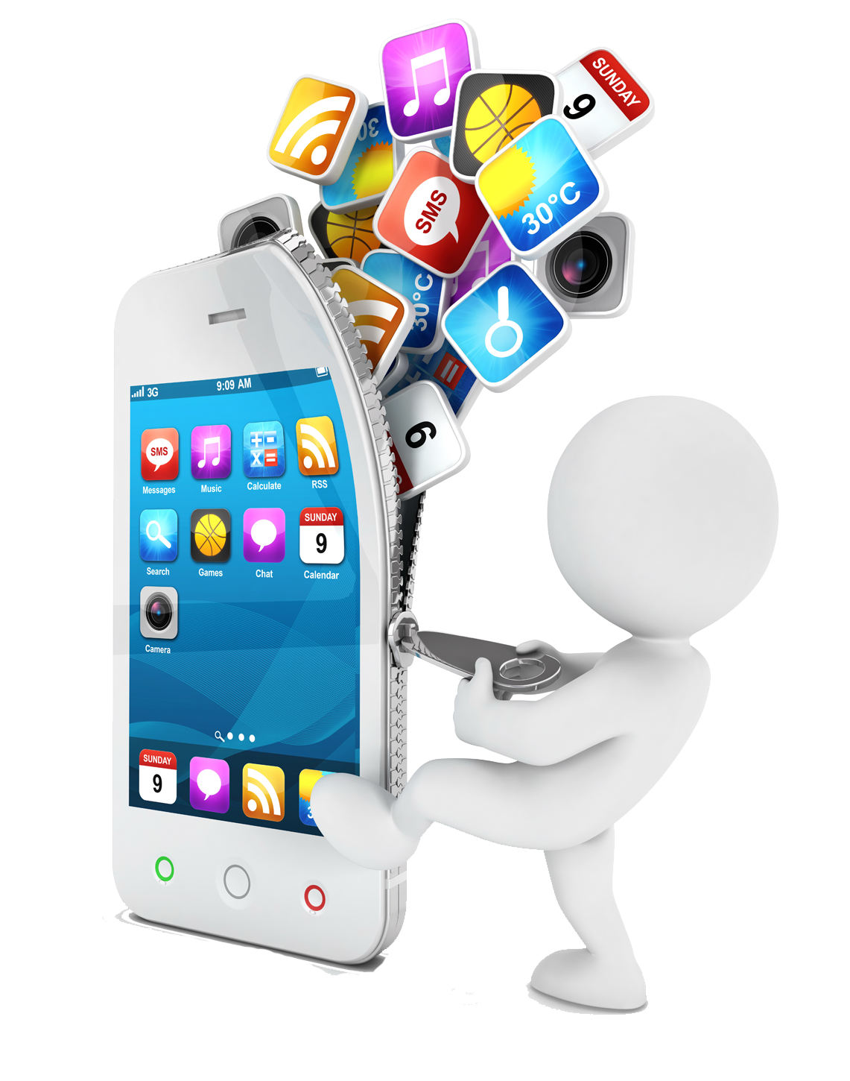
Project Features
Video Transcription
Notification module
Call Recognition
Sign-Language classifier
Text-Audio Conversion module

Slide 5
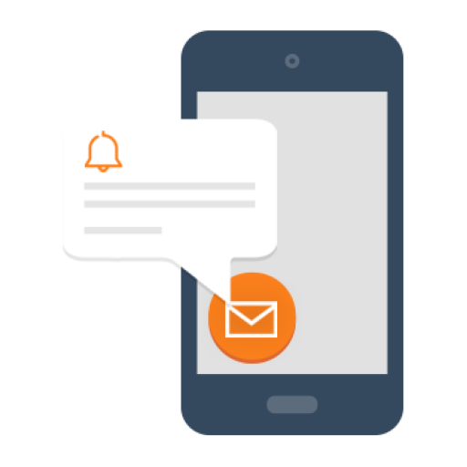



Speech-Text
Using speech to text we can convey what the others were talking by capturing the Audio from the Detected direction

Slide 6
Sign Language Detection
This feature is mainly added for the deaf person who hadn’t learned sign language due to certain circumstances
The role of Sign language classifier is to tell the deaf user what is happening around him and to make the dumb user to interact with others like a normal.
Our Sign-language system is trained with 4 different Sign-languages, ASL, ISL, BSL, FSL. Moreover, our Sign language can work with text, action, audio, image and delivers the output in the form of audio, text, Sign-Language.

Slide 7
Working Model
For Deaf we had added.
Speech/ Text ->Sign-Language , Audio&Text
Action/ Gesture-Sign-Language -> Audio&Text
For Dumb we had added.
Text ->Sign-Language, Audio&Text
Action/ Gesture –Sign-Language- >Audio&Text
For a Normal User (Doesn’t know Sign-Language)
Speech/ Text ->Sign-Language, Audio&Text

Slide 8
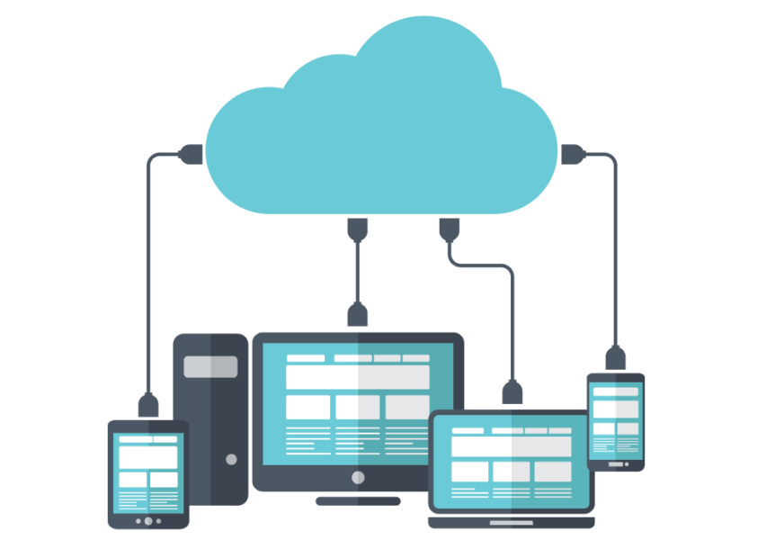
FUTURE WORKS
Live Captioning.
Cloud Storage.

Slide 9
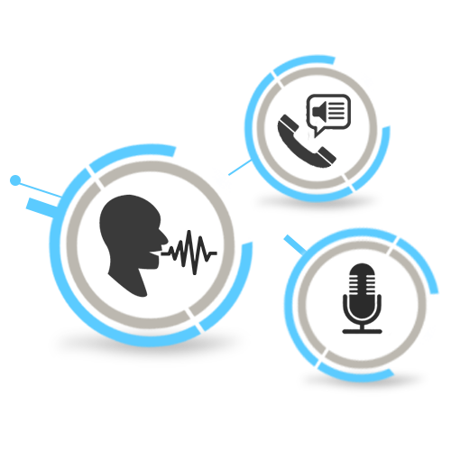
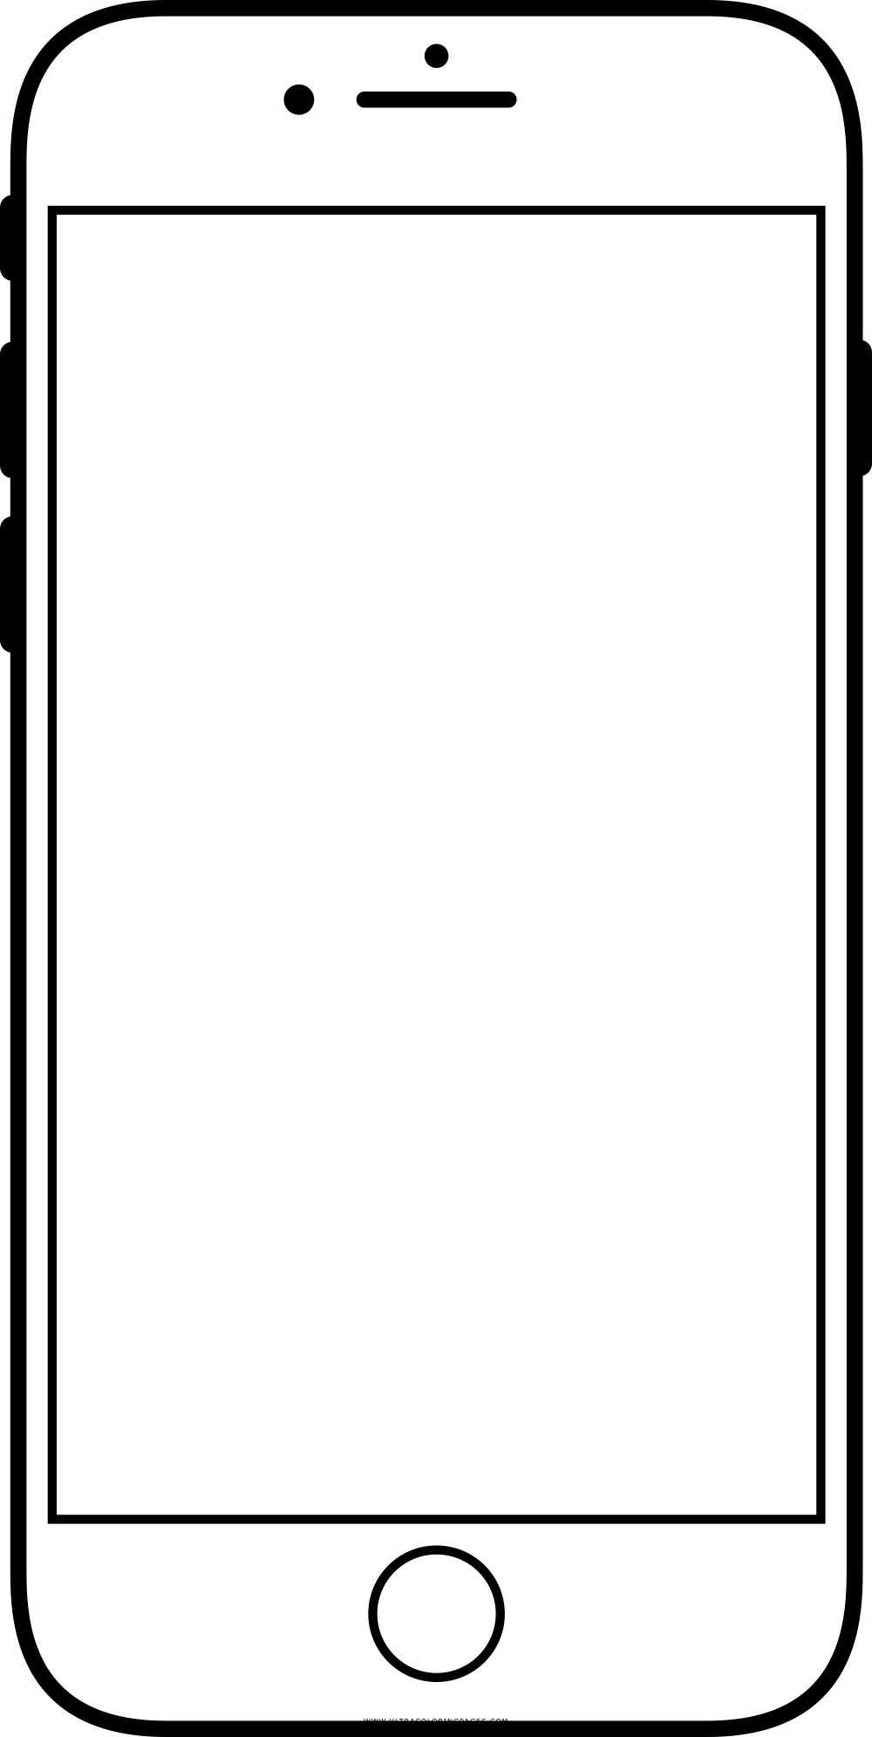
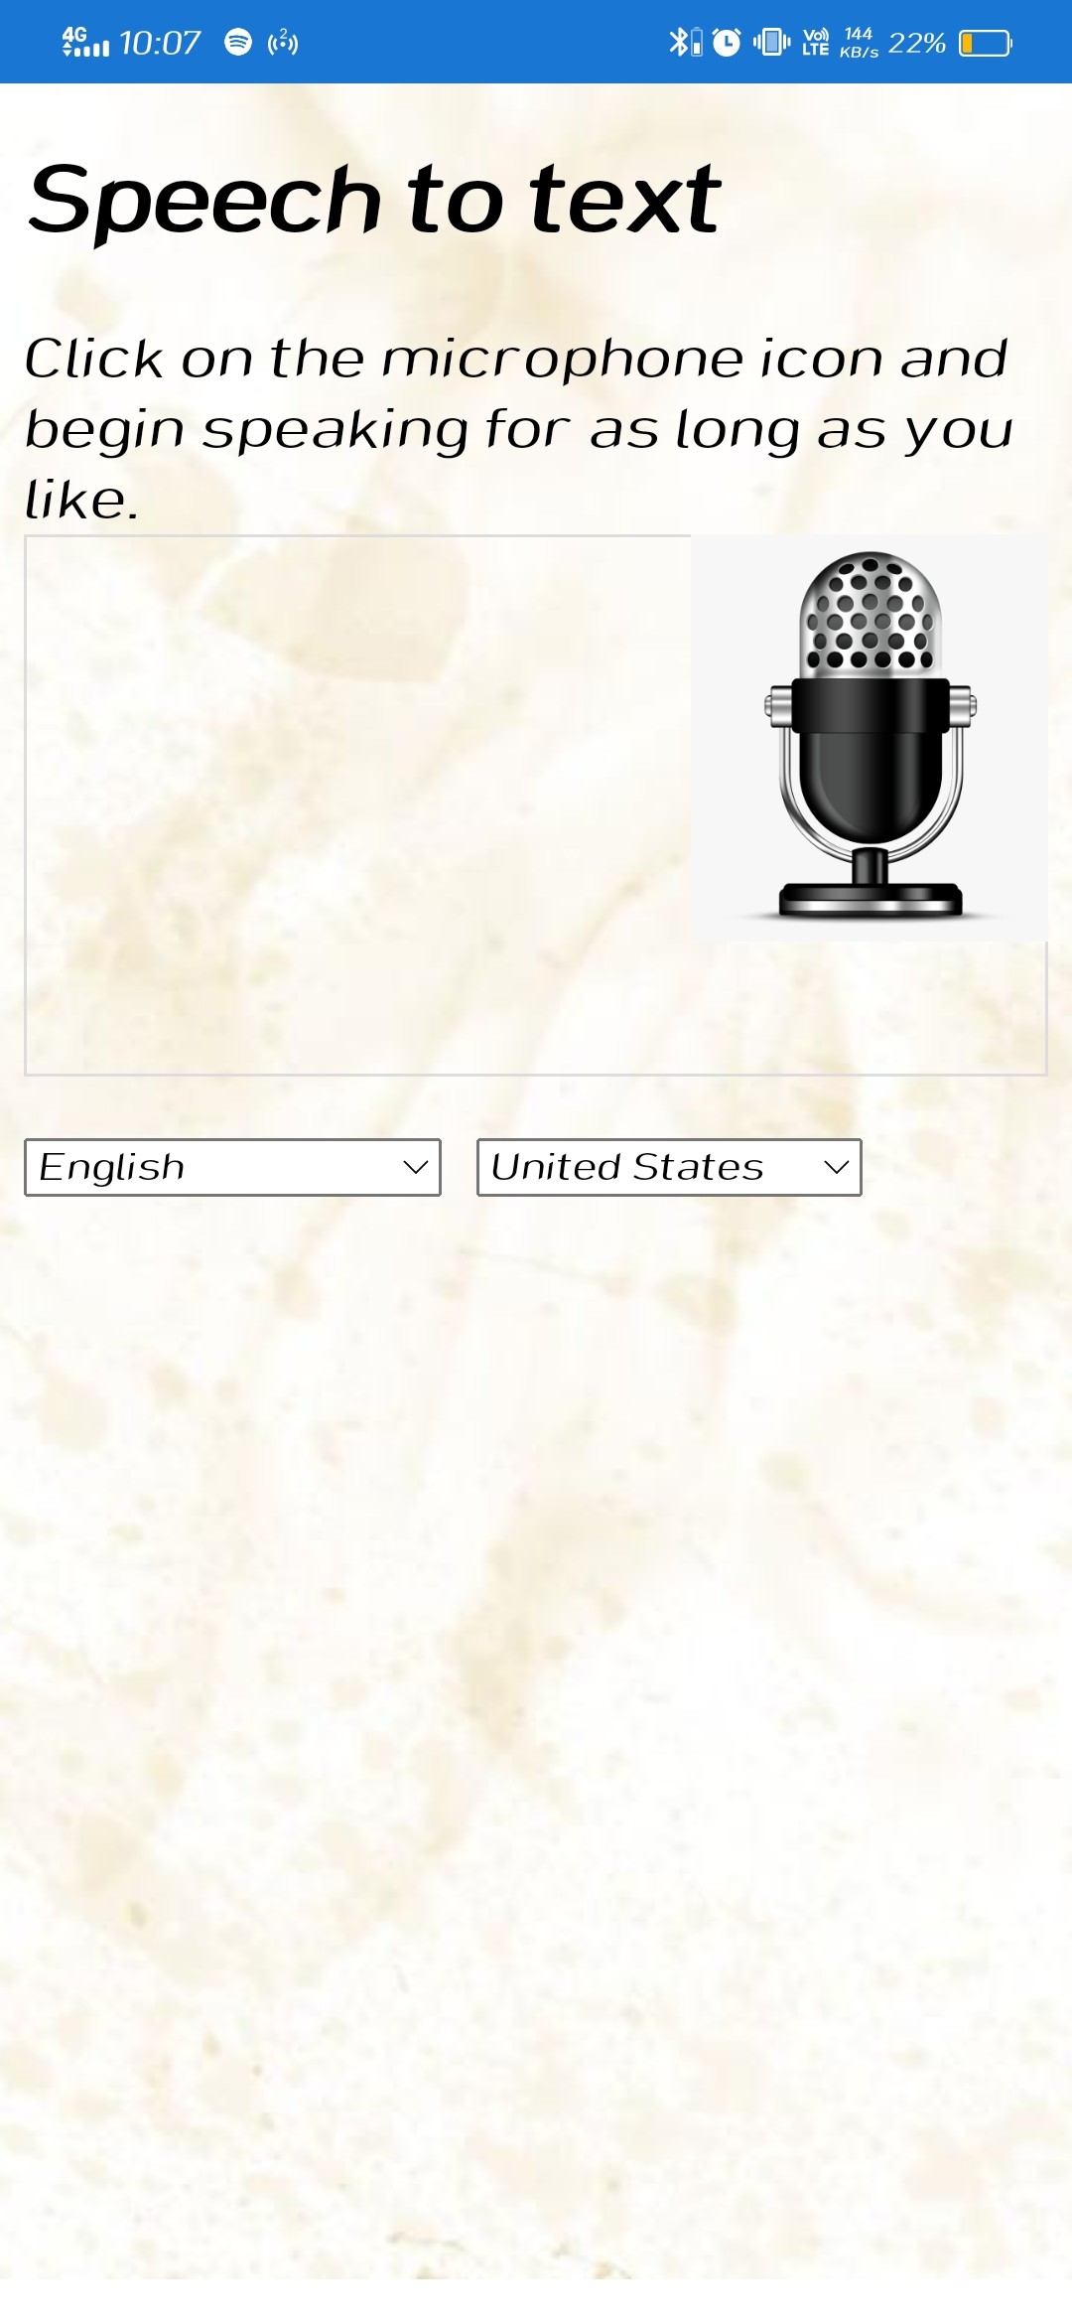
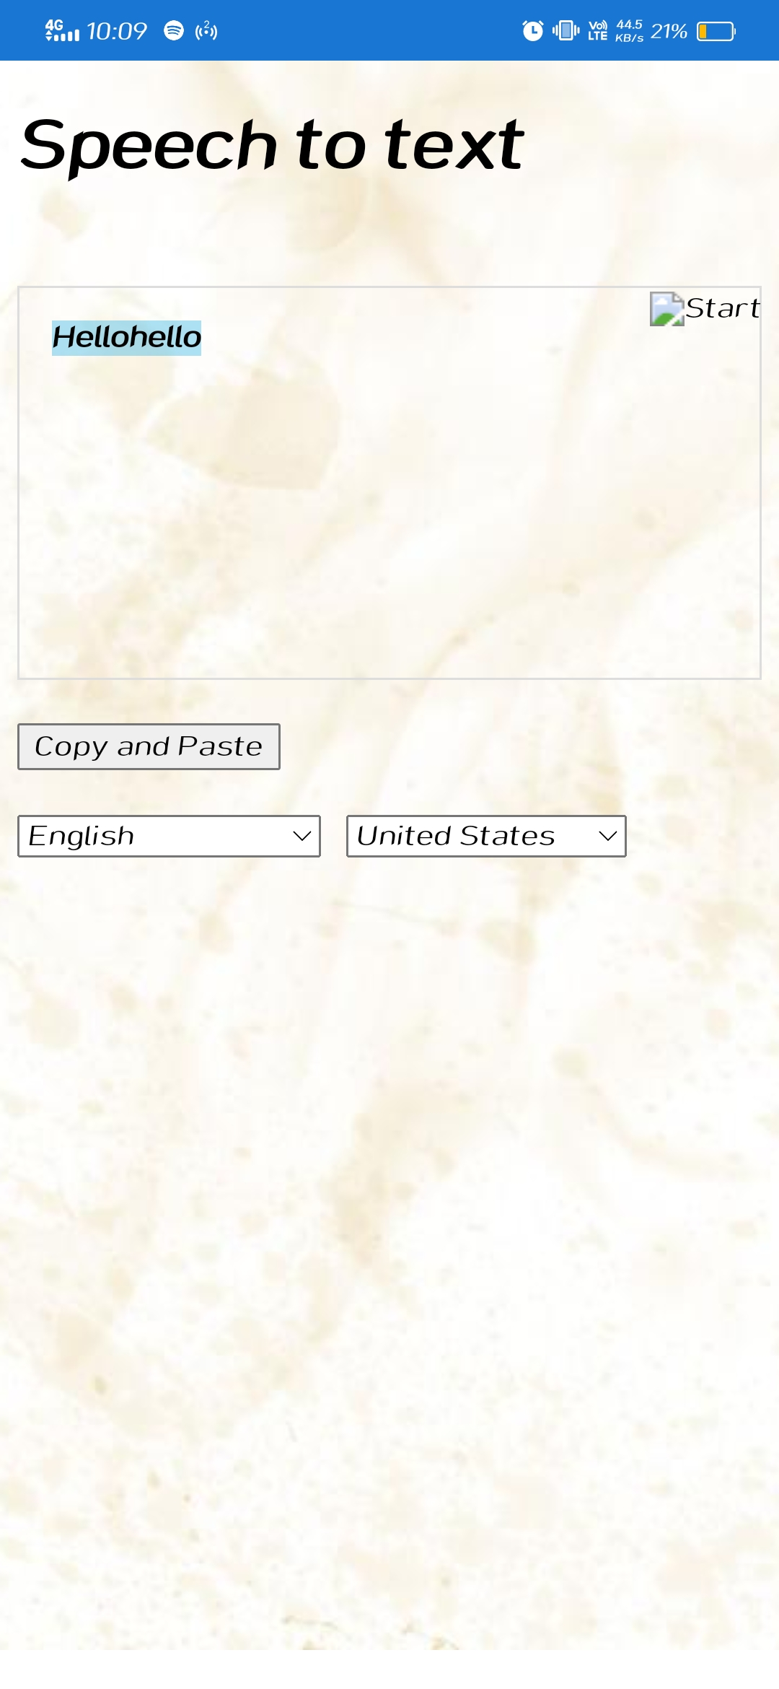
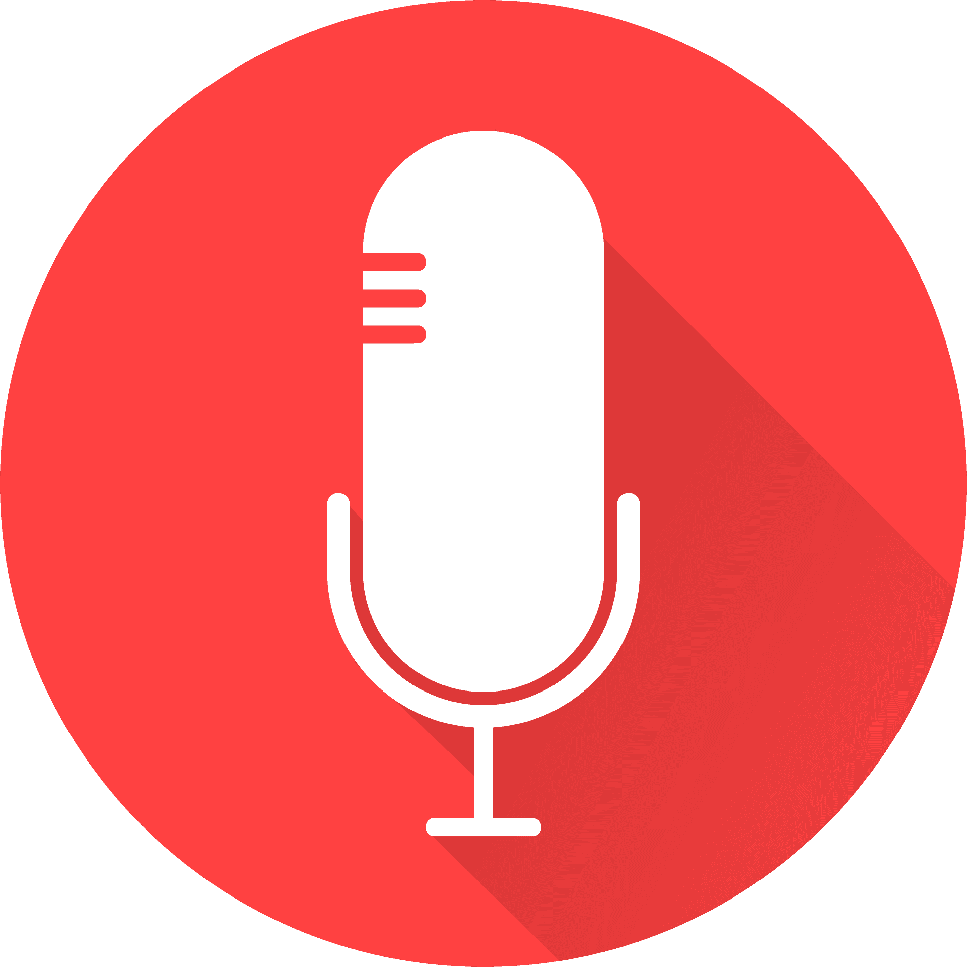
Speech to Text
This is speech to- text

Slide 10
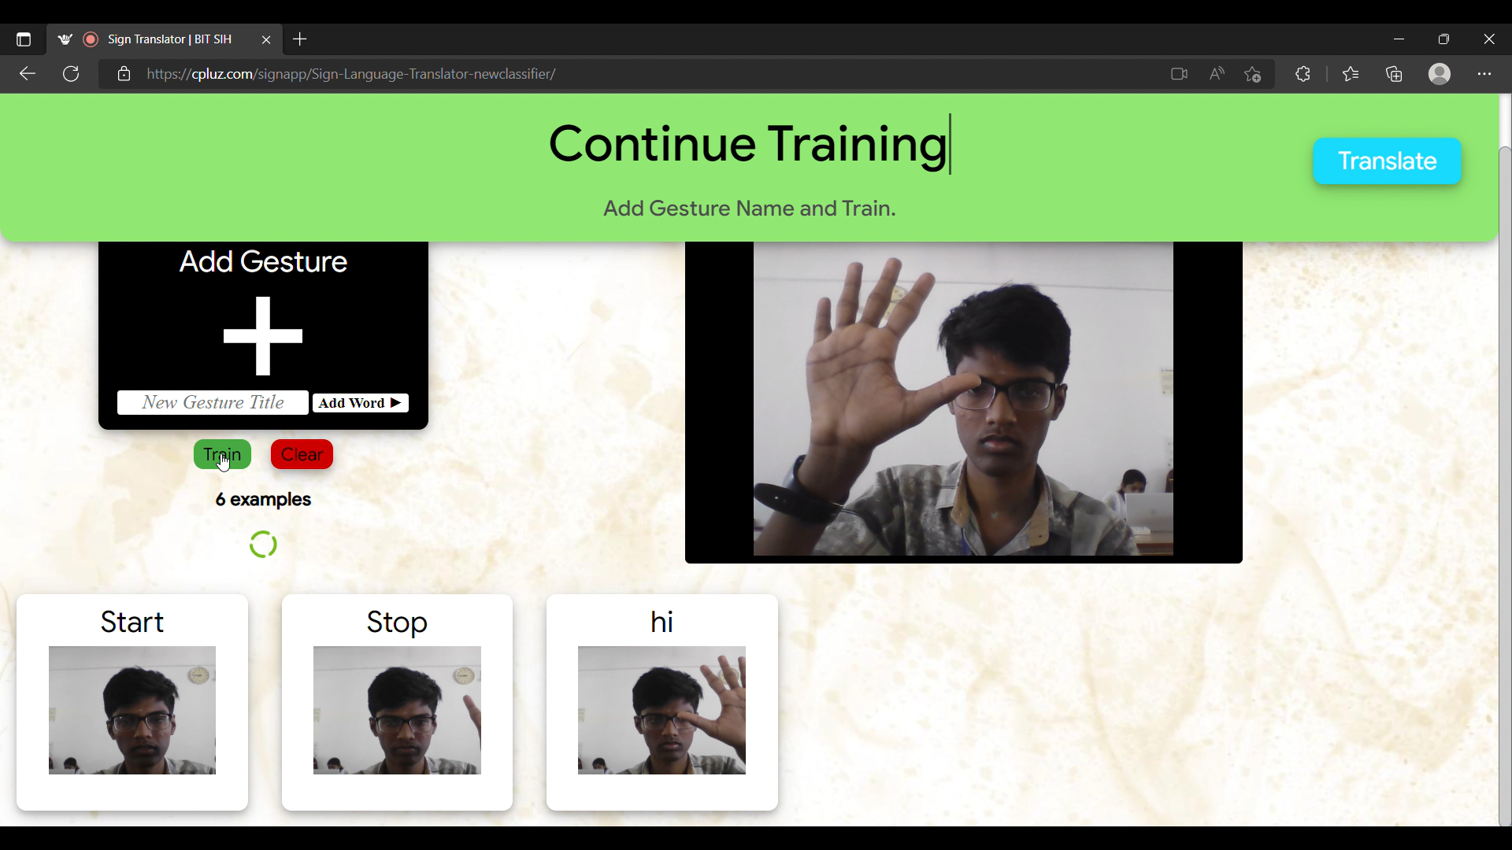
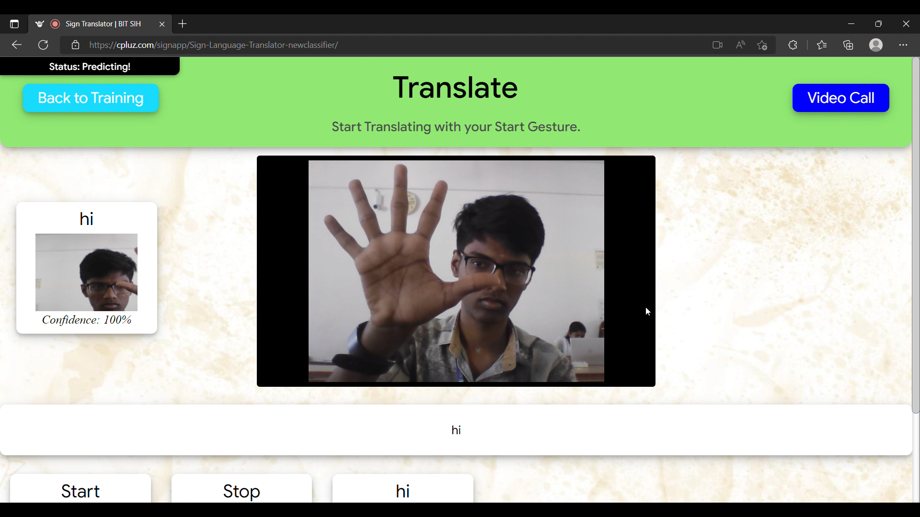

SIGN-LANGUAGE
FaceTime
User can add their own
gesture.
Video Call
Cloud storage

Slide 11

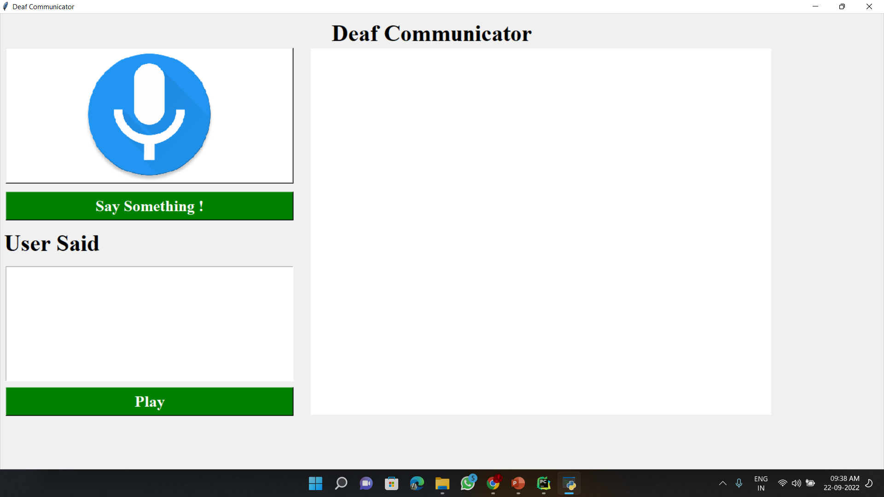
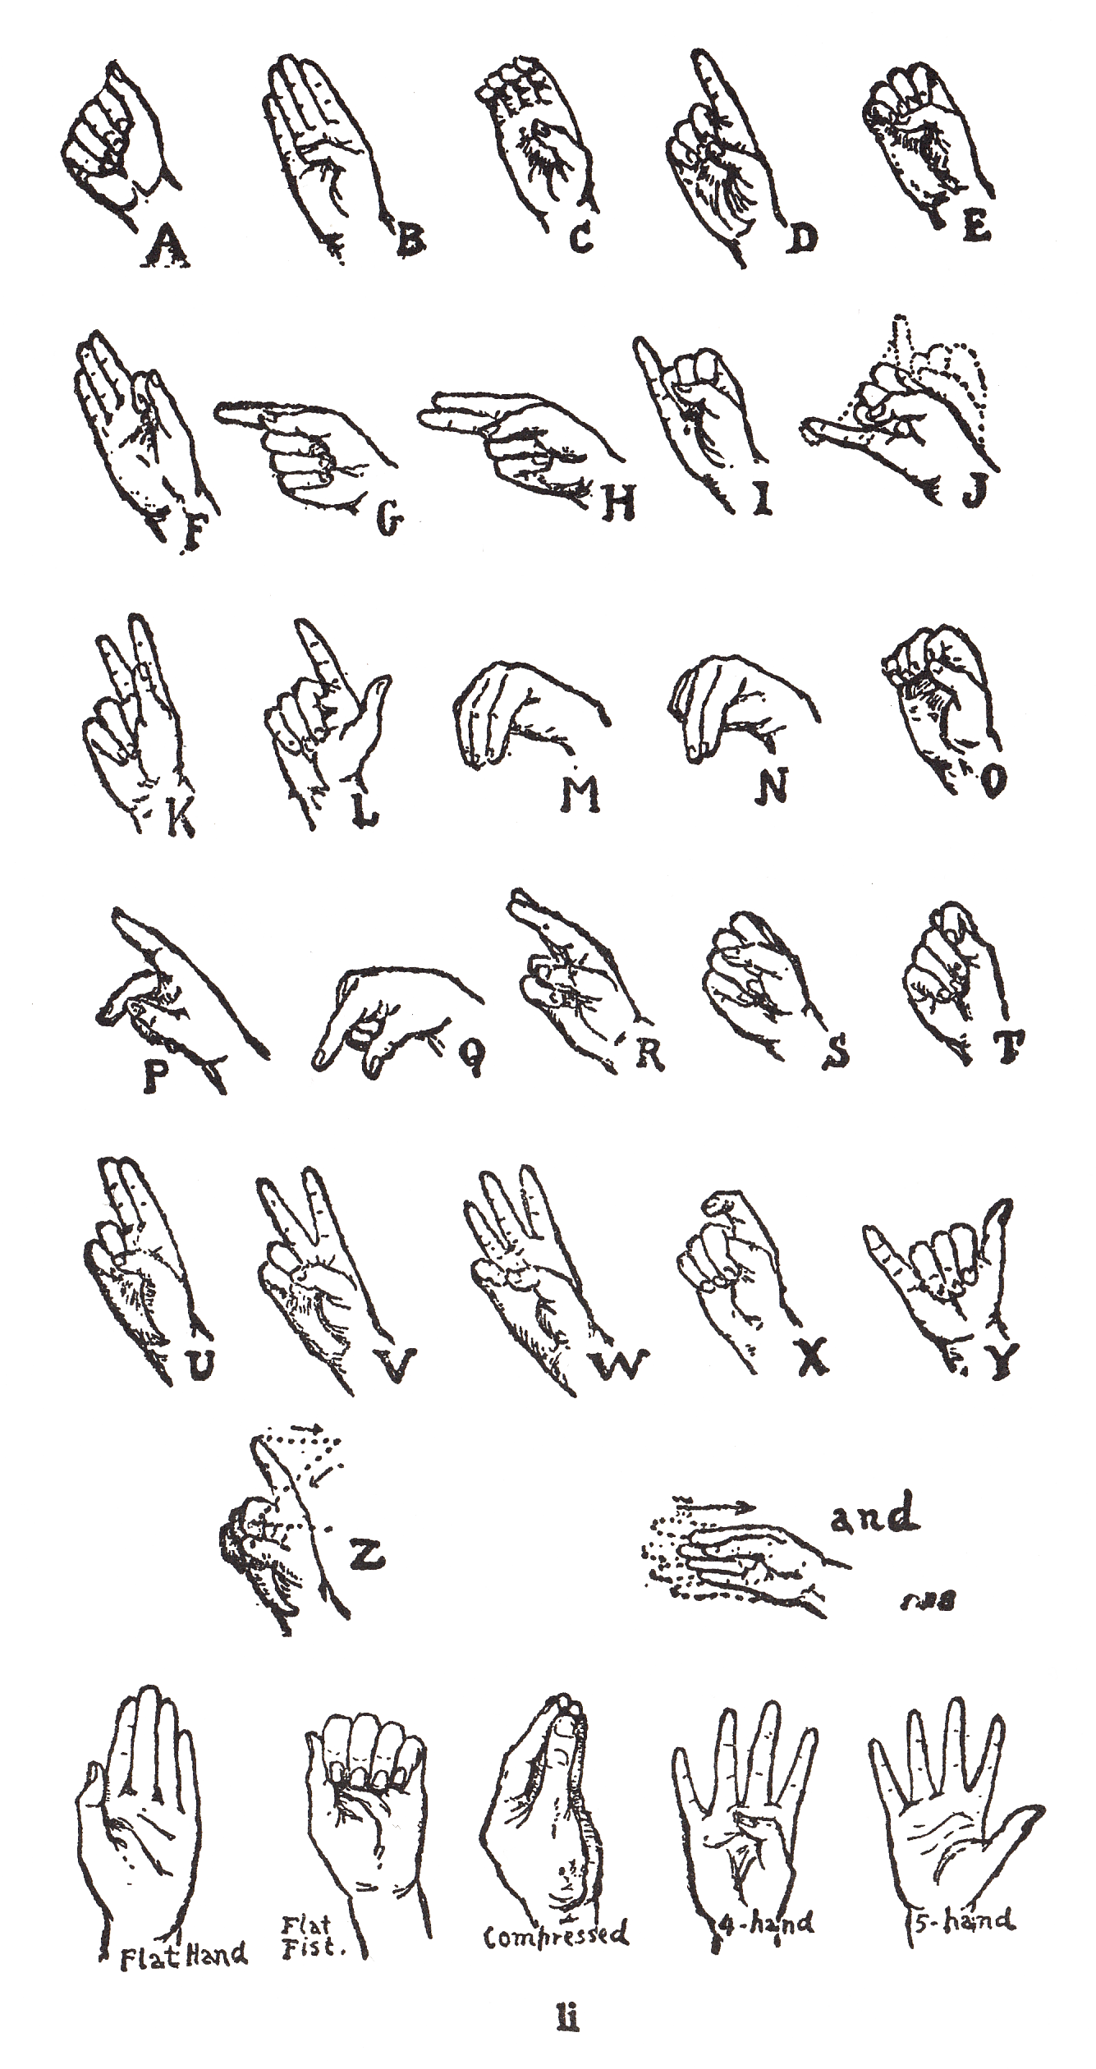

Speech to Sign-language
Text to Sign-Language
Asl with Text
Deaf Communicator

Slide 12
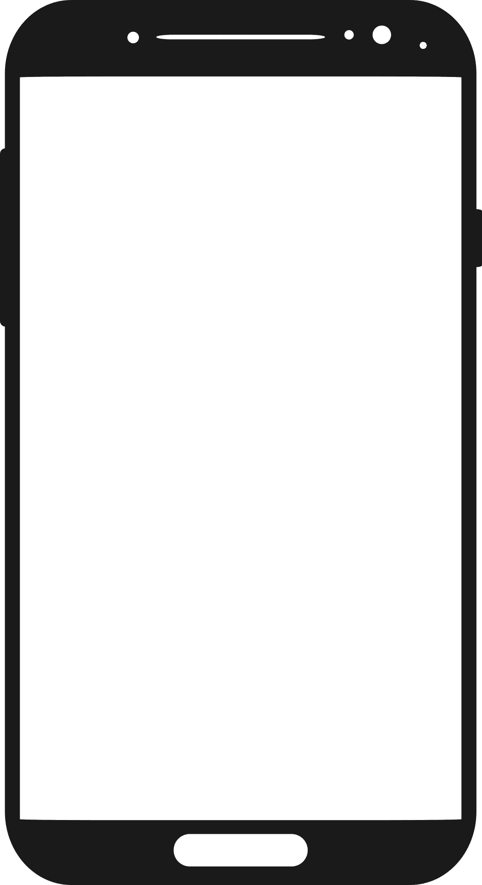
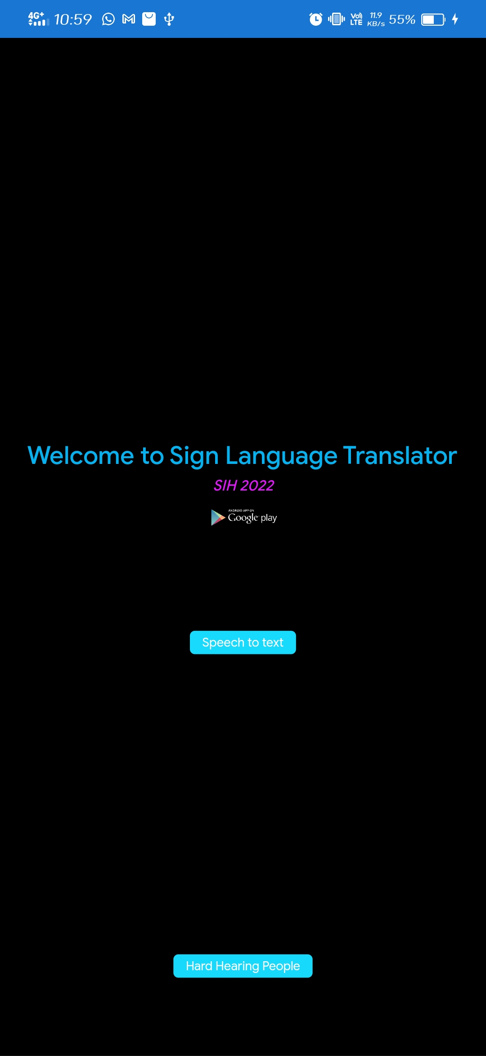

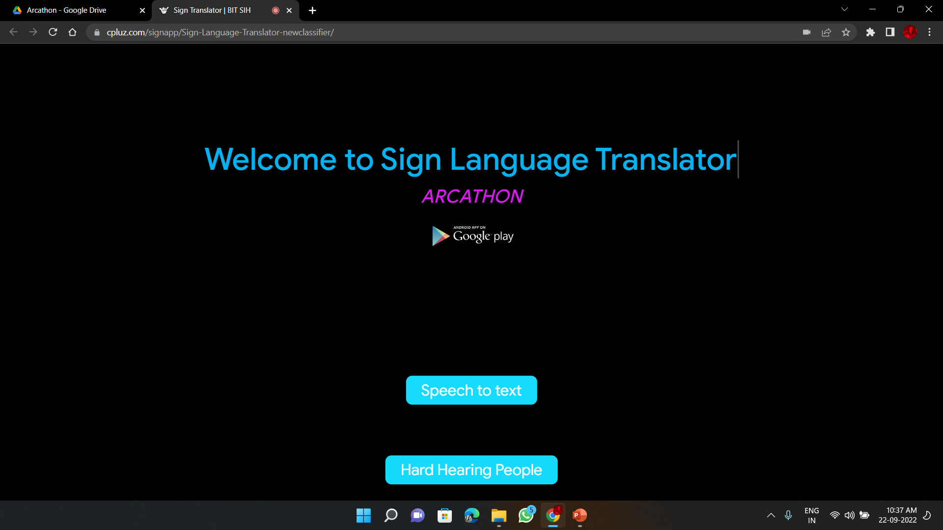

Action / Gesture Sign-Language

Slide 13
Thanks!

